Slide 1
NOMAD / FAIRmat
Enabling material scientists to define, share, and use data
Markus Scheidgen
NOMAD, FAIRmat, IRIS, Physik, HU Berlin

Slide 2
Agenda
What is NFDI, FAIRmat, and NOMAD
How does NOMAD work?
Demo
Comparison to other ELNs

Slide 3
What are NFDI / FAIRmat / NOMAD
nfdi
nfdi: Nationale Forschungsdaten Infrastructure, link
(national research data infrastructure)
FAIRmat: NFDI consortium for FAIR materials science data, link
(FAIR: findable, accessible, interoperable, re-usable)
FAIRmat
NOMAD
NOMAD: A web-based service and software for managing FAIR materials science data, link
FAIRmat uses NOMAD to build a federated infrastructure of connected NOMAD installations

Slide 4
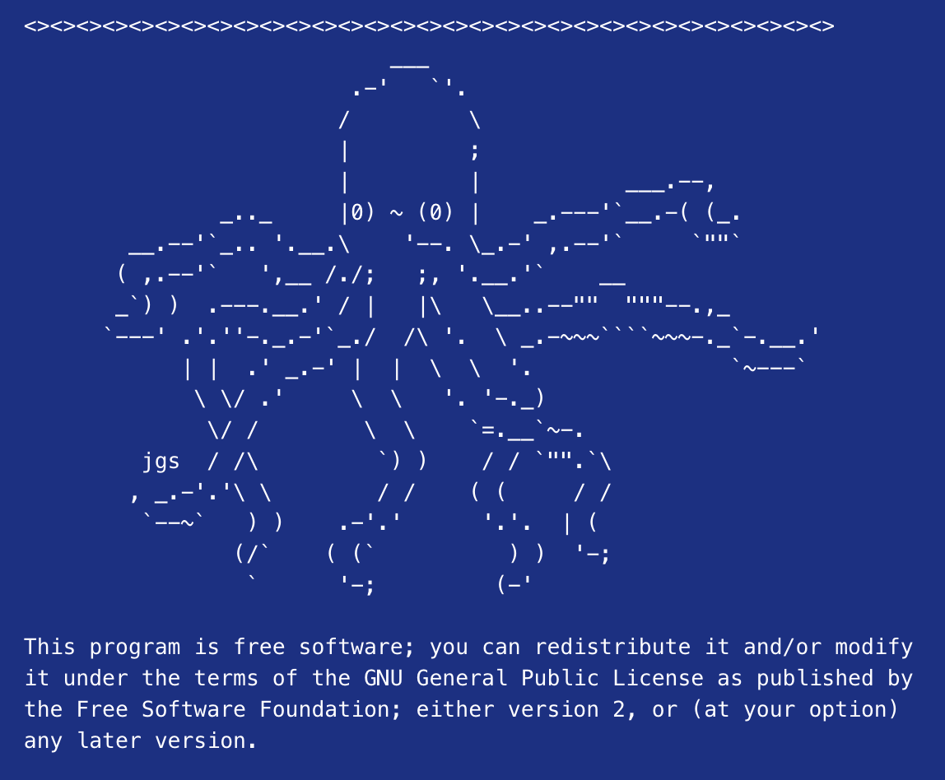
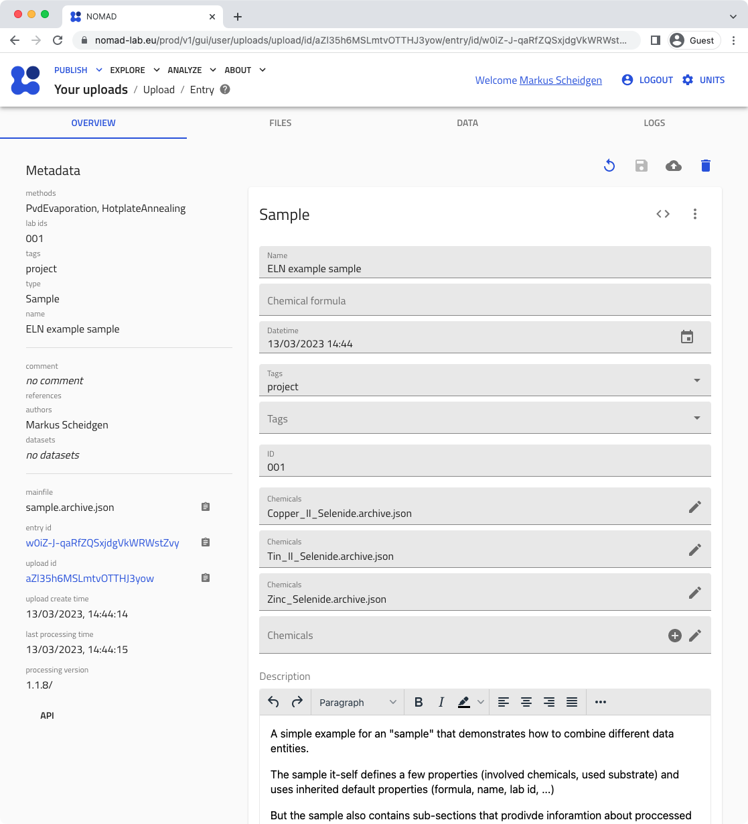
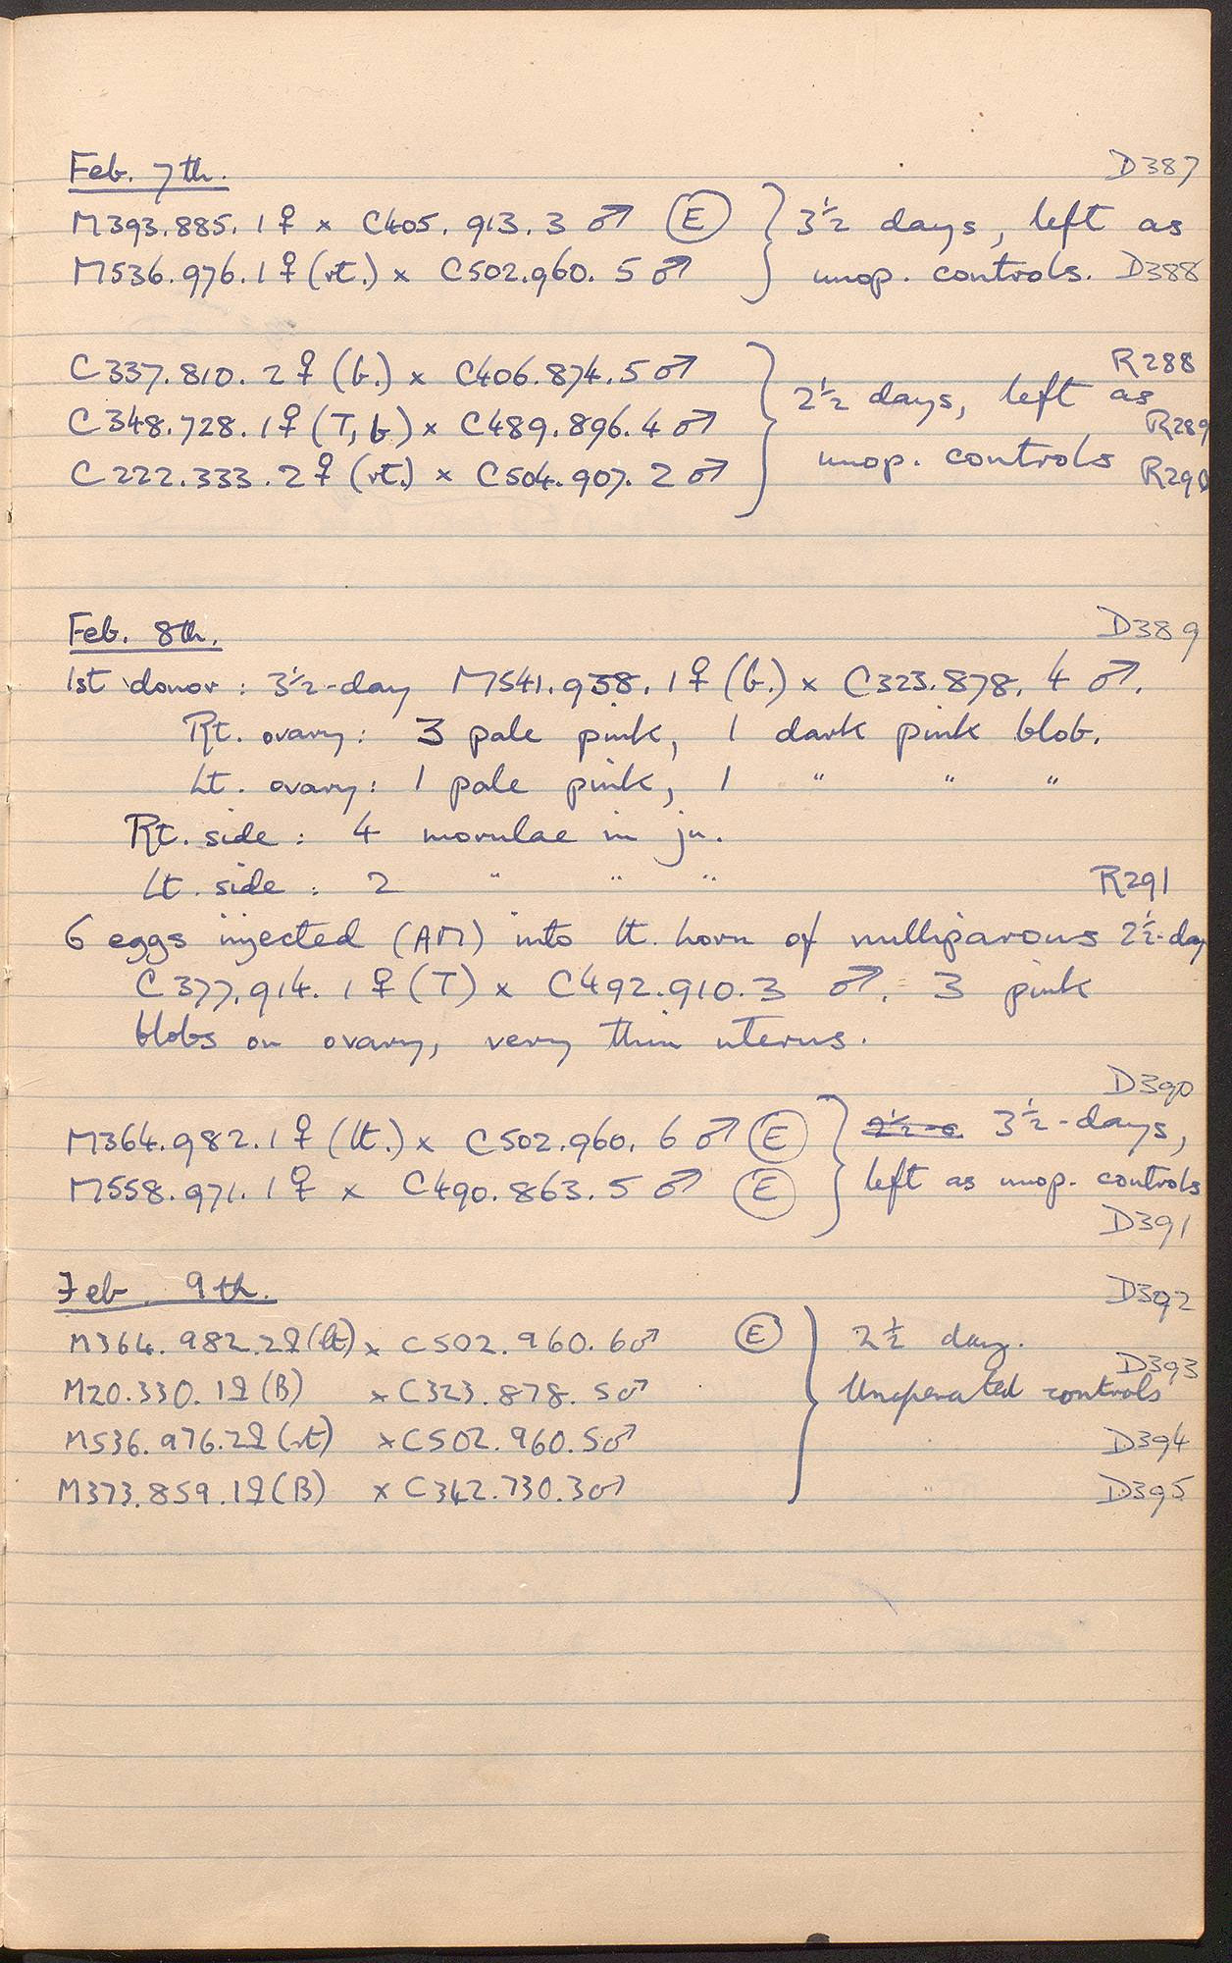
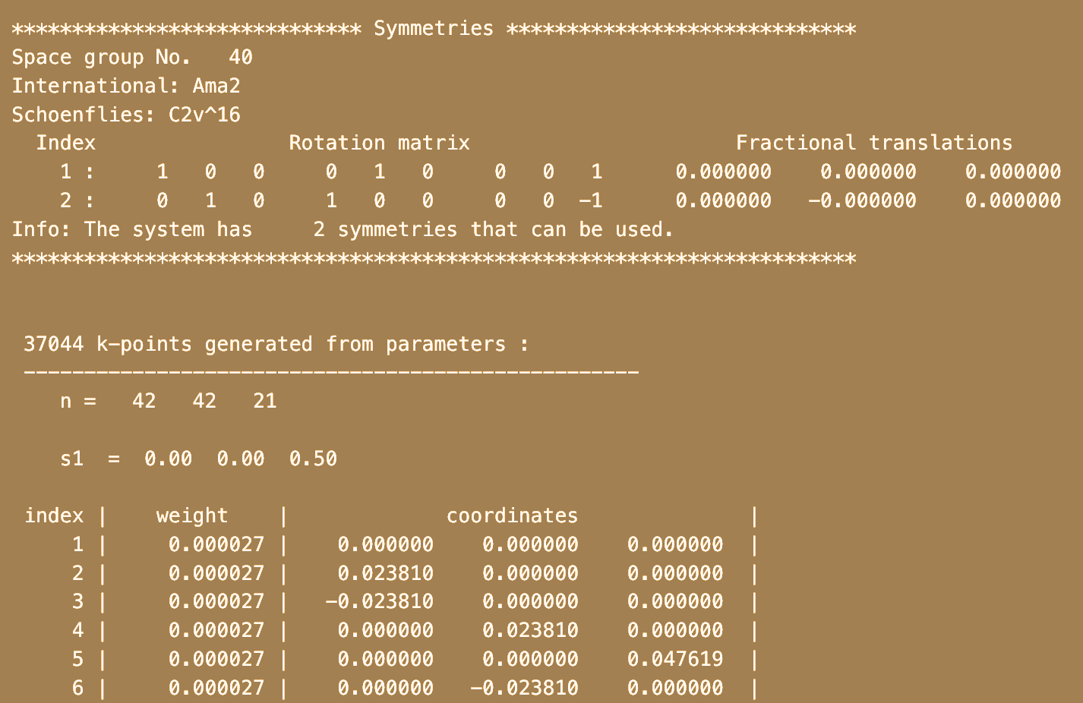
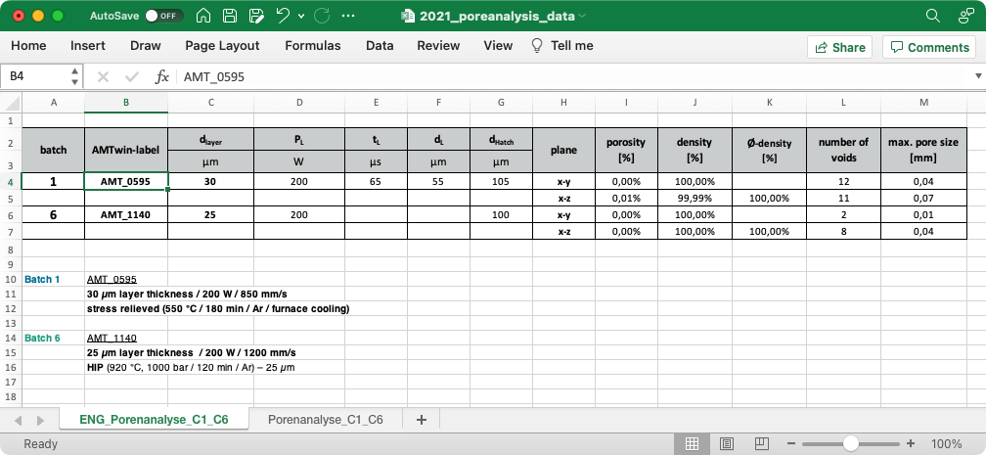
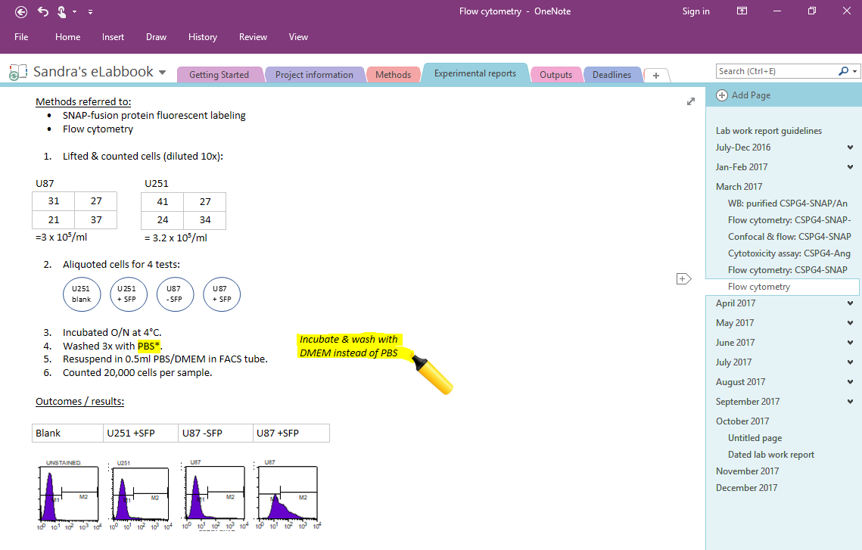
Unstructured data, structured data, and schemas

Slide 5
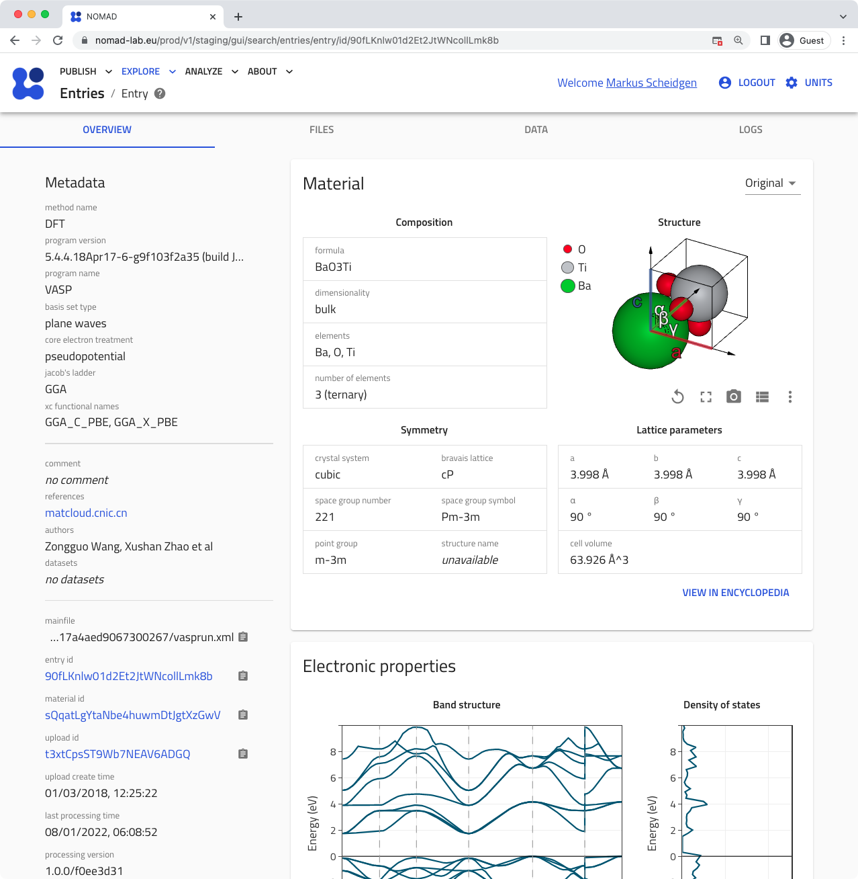
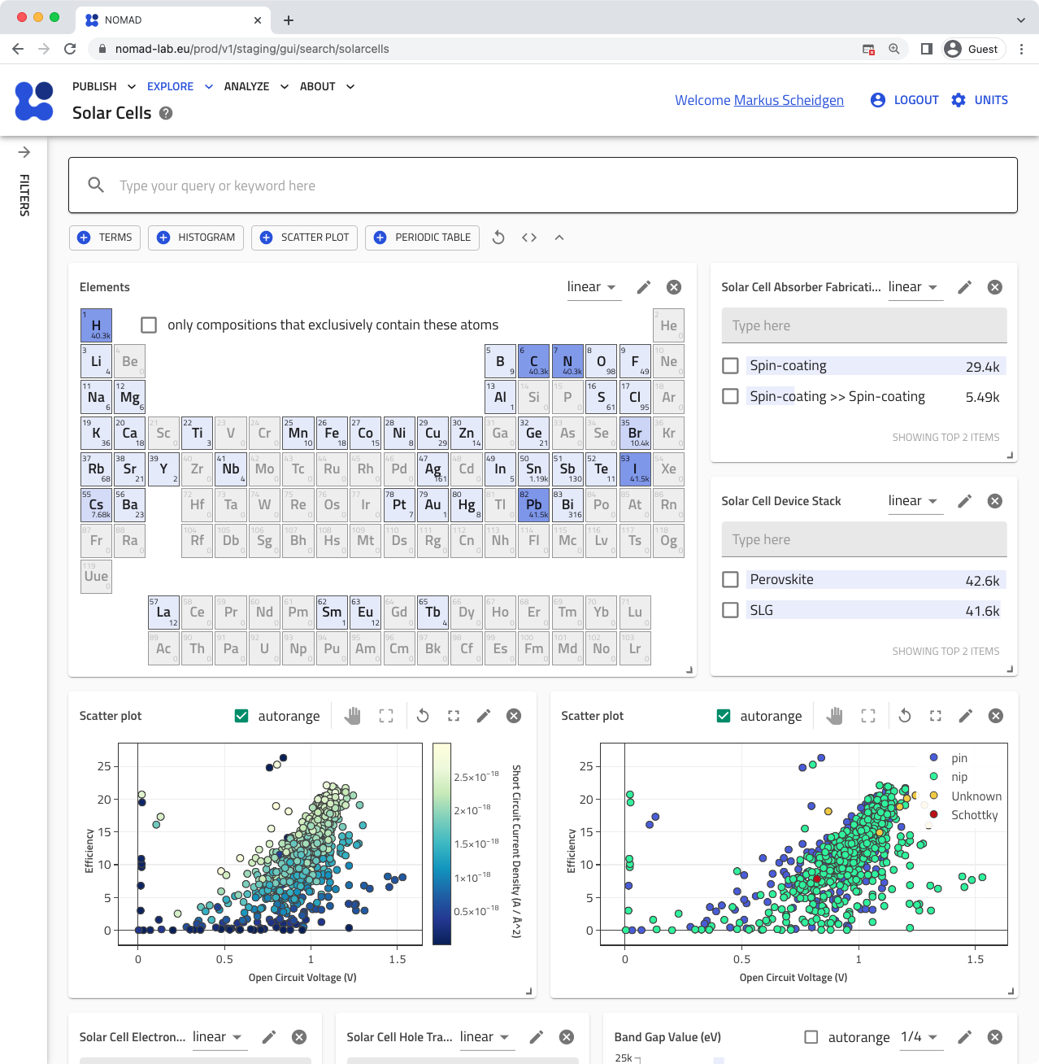
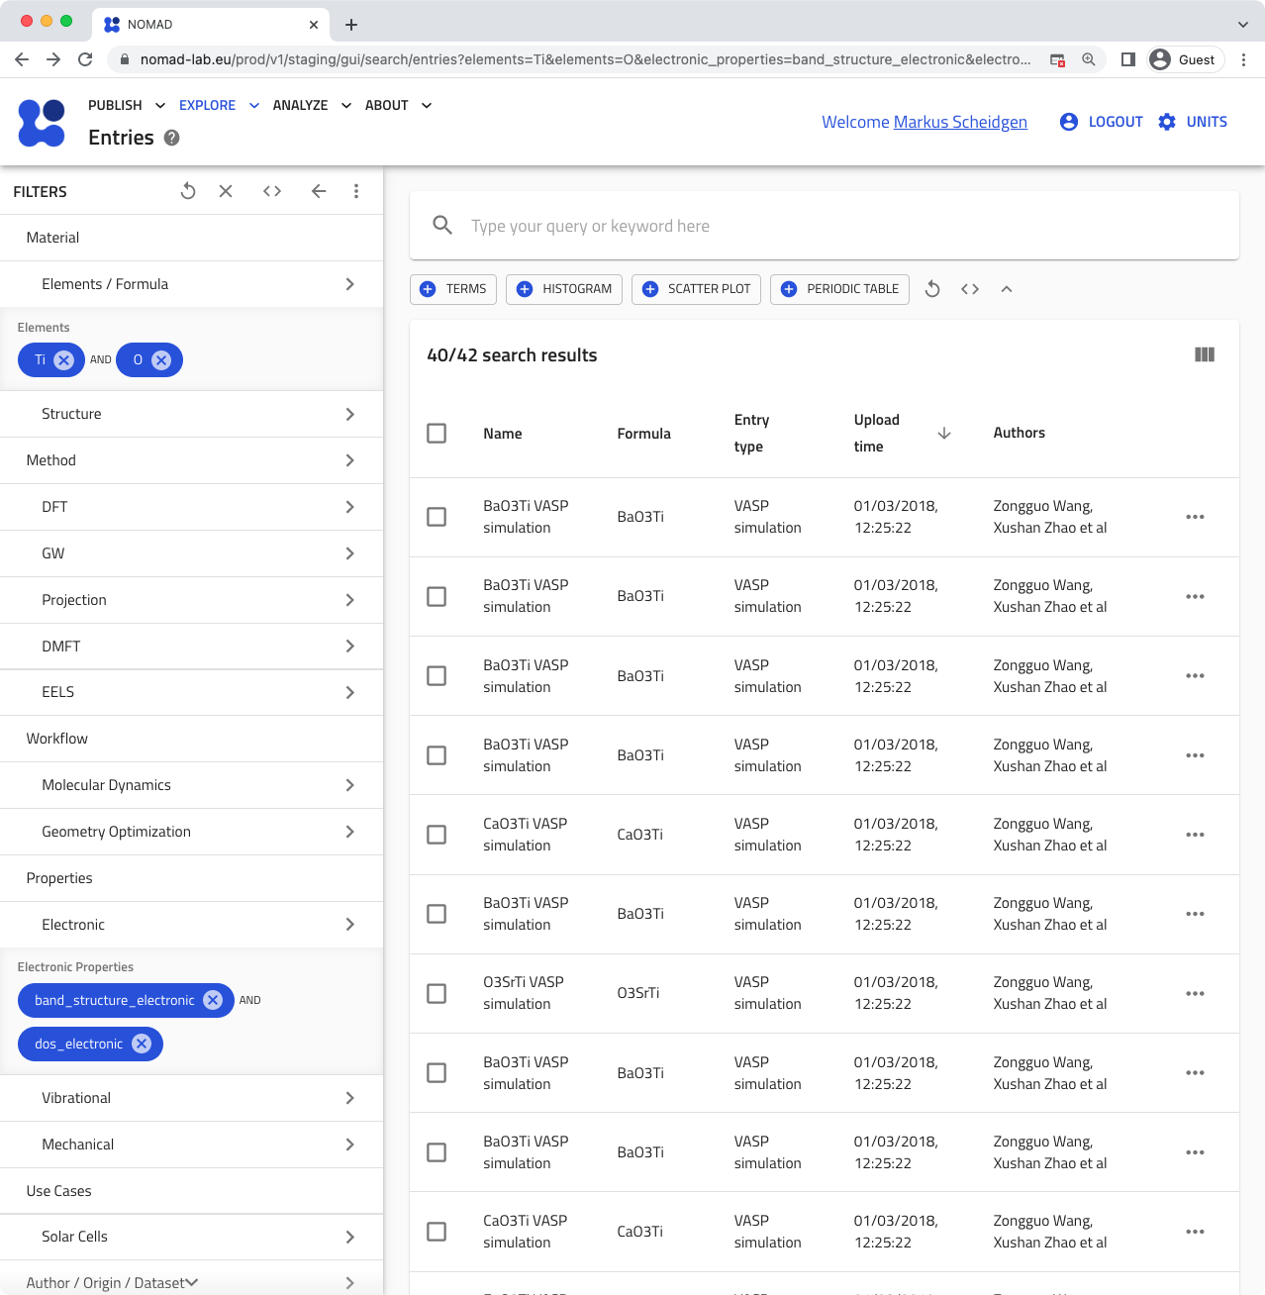
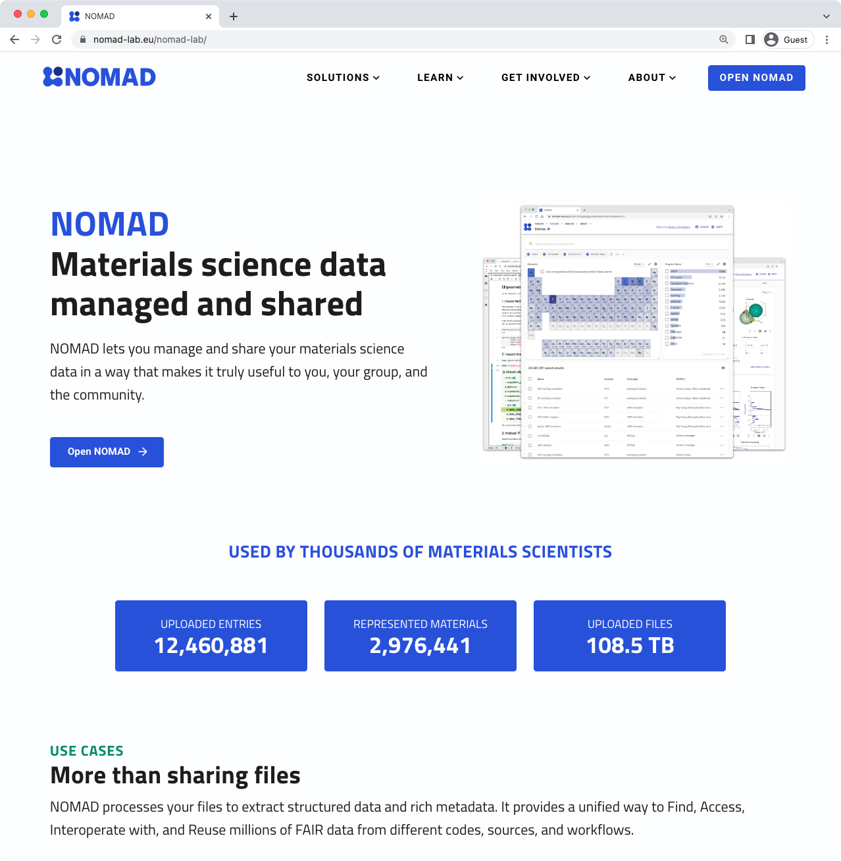
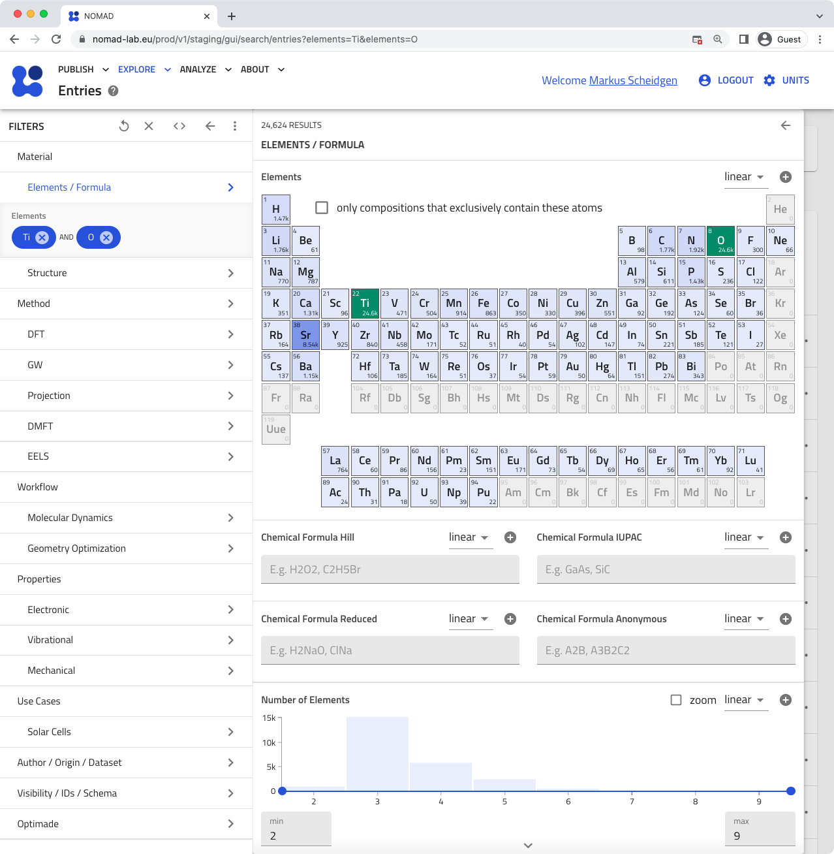
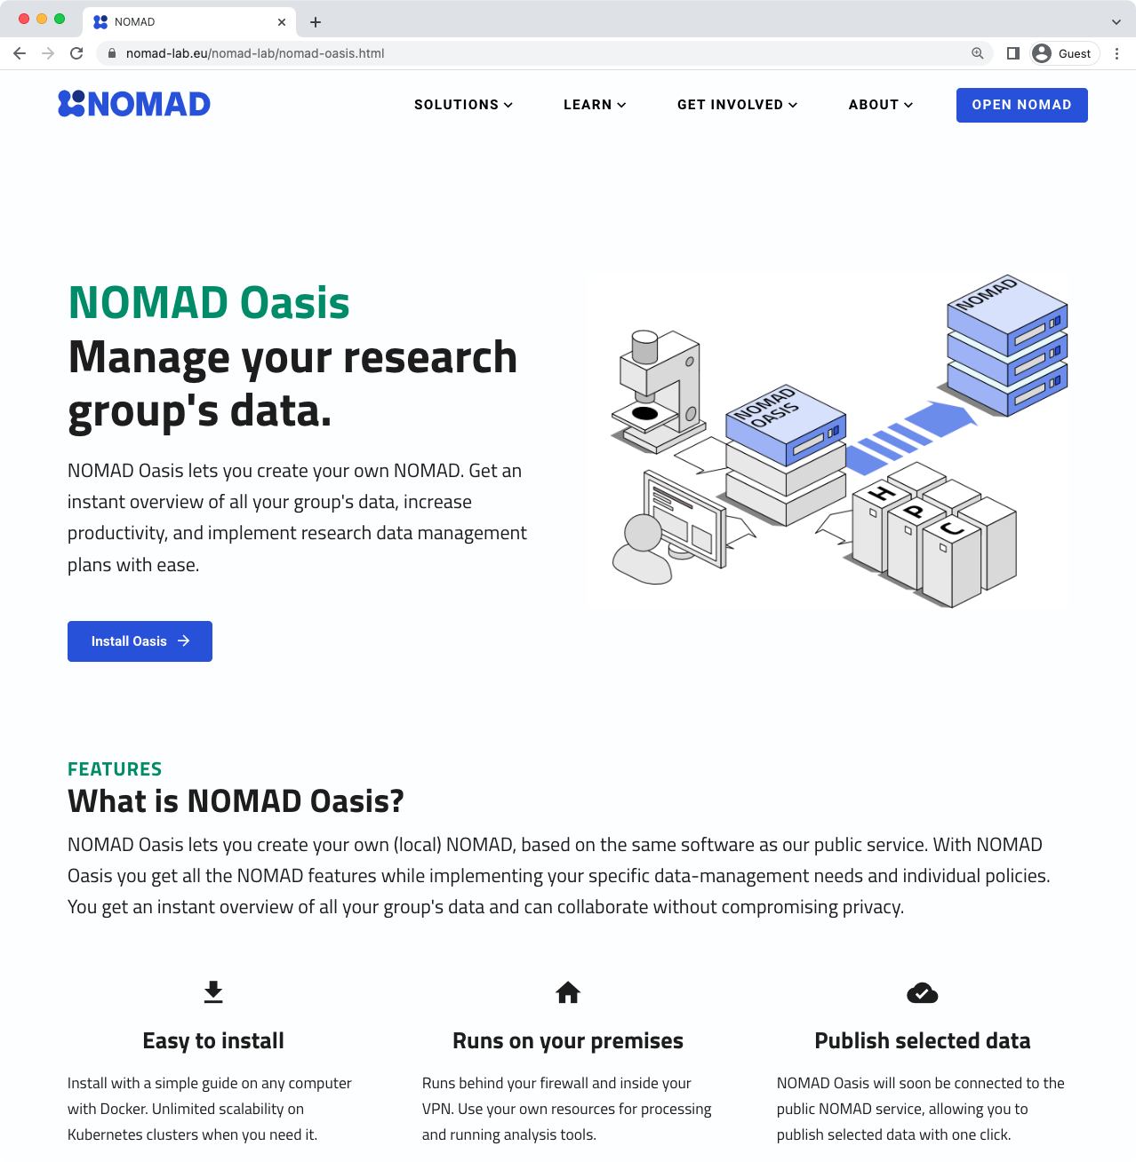

Slide 6
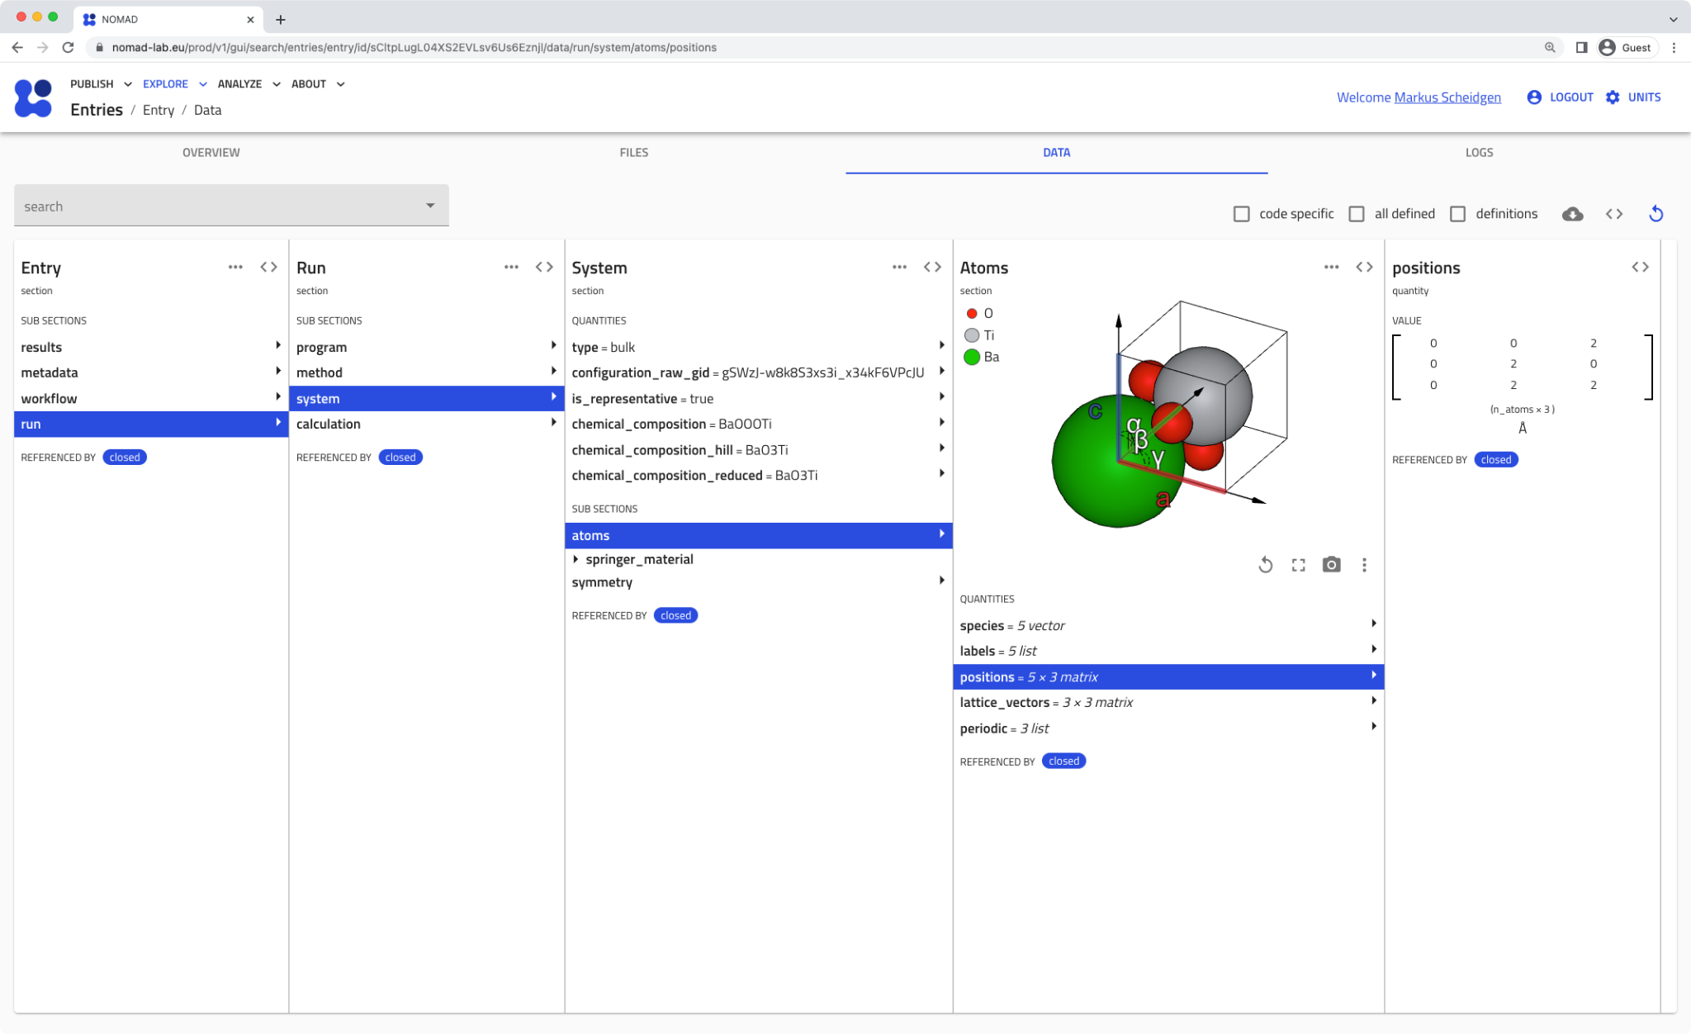
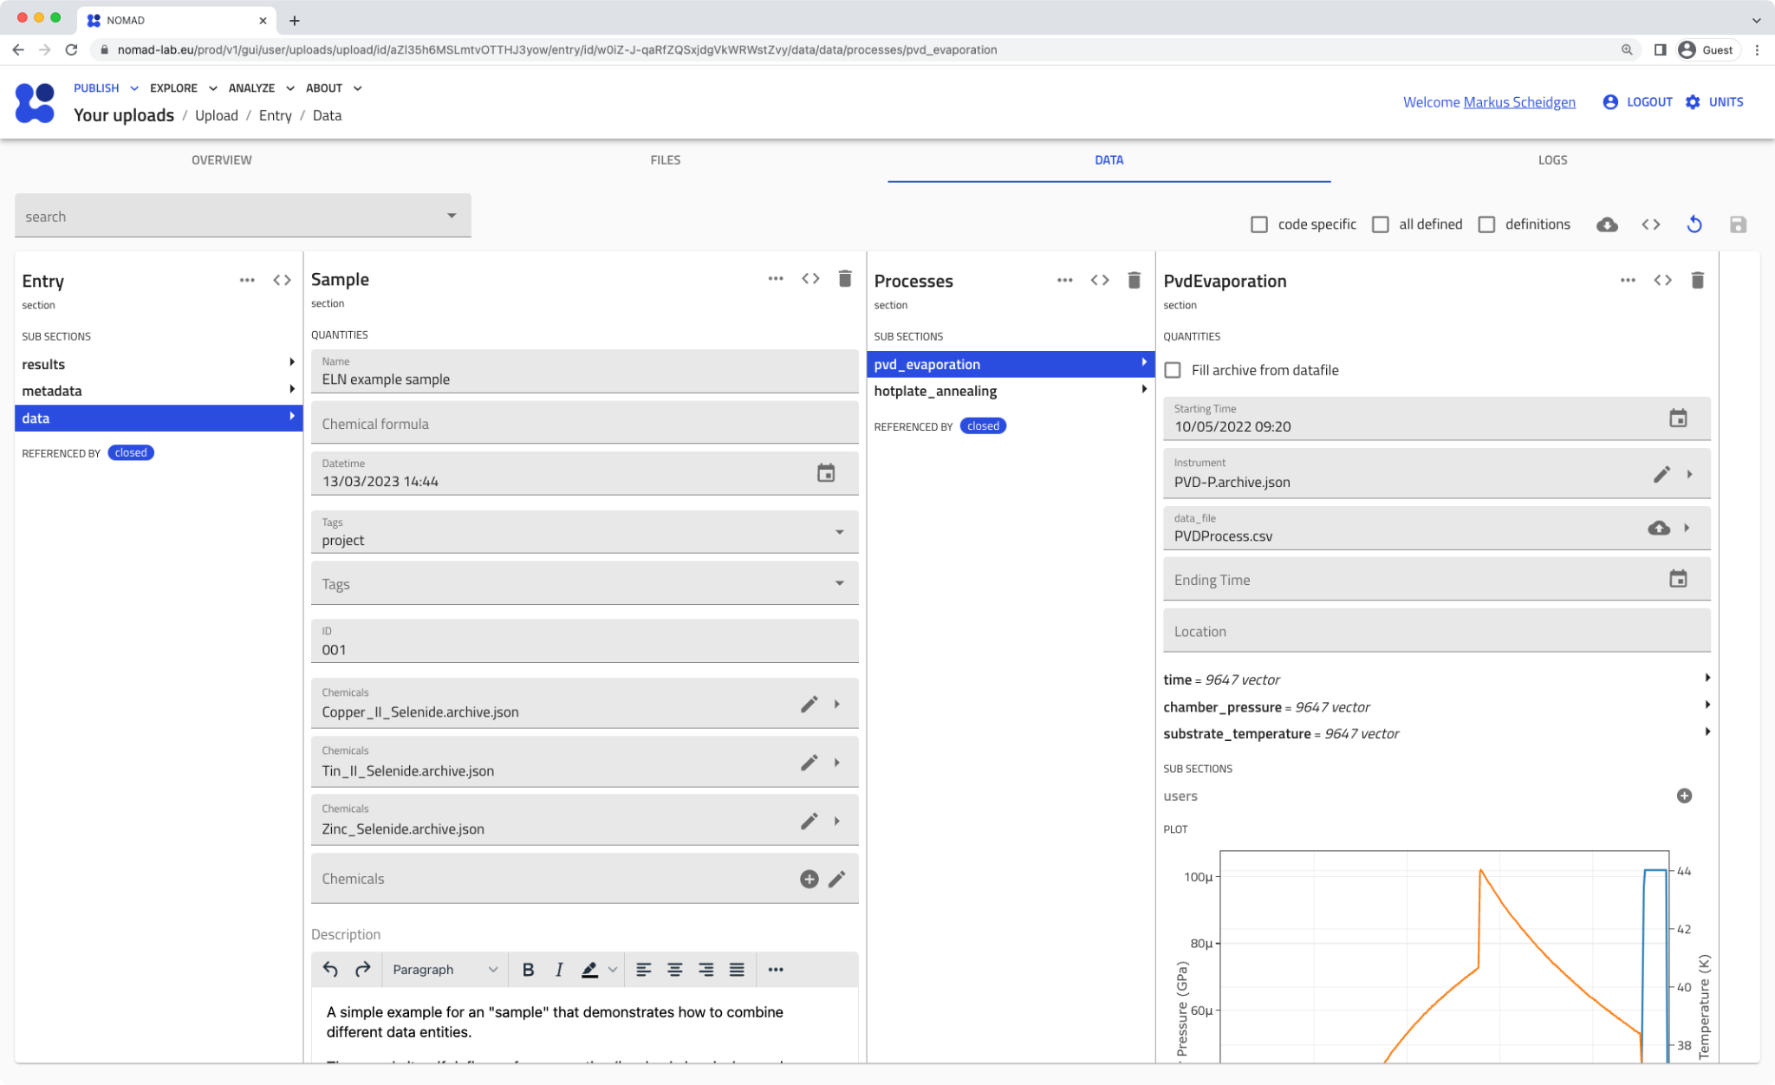

Slide 7
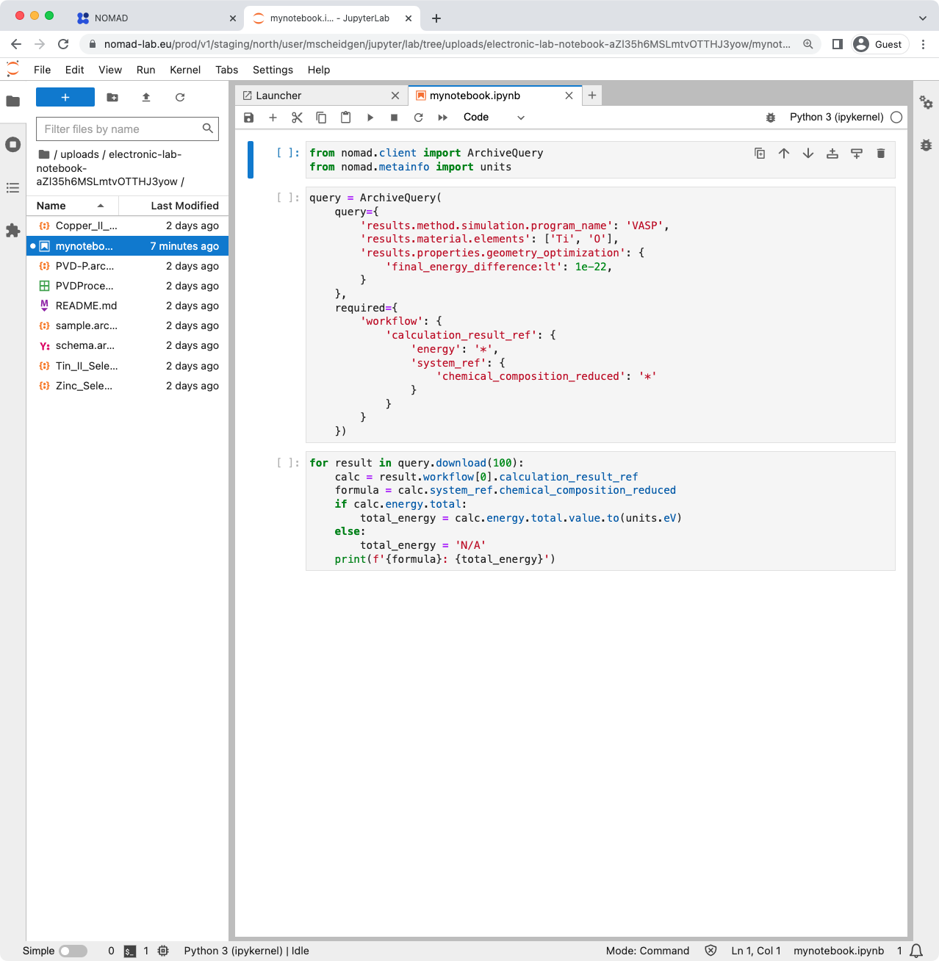

Slide 8
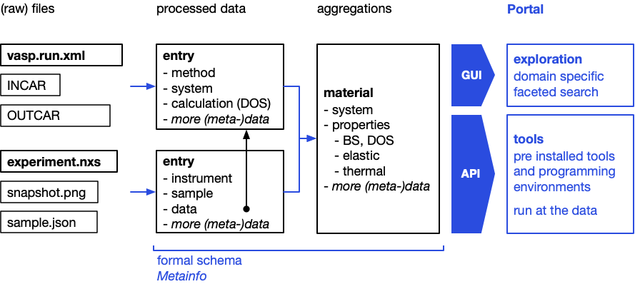
Extracting structured (meta-)data from files

Slide 9
demo

Slide 10
Pros
Cons
schema-focused, produces consistent FAIR data
supports growing number of file-types, e.g. neXus
file-based, easy to import and export
API covers all functionality
integrated JupyterHUB to work with and analyse managed data
data can be shared and published through a central NOMAD
schema-focused, requires you to structure data first
designed to be extendable, adapt NOMAD to your needs
integration with others ELNs has just begun
young constantly evolving project, not all features are there yet
FAIR, extendable, scalable:
simple, low maintenance:

Slide 11
NOMAD Links
homepage – nomad-lab.eu
central NOMAD service – https://nomad-lab.eu/prod/v1
NOMAD Dokumentation
installing Oasis
schemas and ELNs
Tutorials and videos
NOMAD Oasis tutorial video playlist
Publishing, Exploring, API video playlist
All FAIRmat tutorials
NOMAD forum
NOMAD’s main gitlab (and github)

Slide 12
Questions?

